Slide 1
ASSET INQUIRY
IN THE FAM
GSM function required: FA Inquiry

Slide 2
To check asset details in the FAM
To check for Assignment (Custodian name and Location)
To check for PO number, Invoice number and Supplier
To check for Asset Financial Information (Date Placed in Service, Original Cost and Cost History

Slide 3
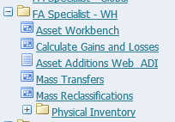
Select FA Specialist – WH
Select Workbench

Slide 4
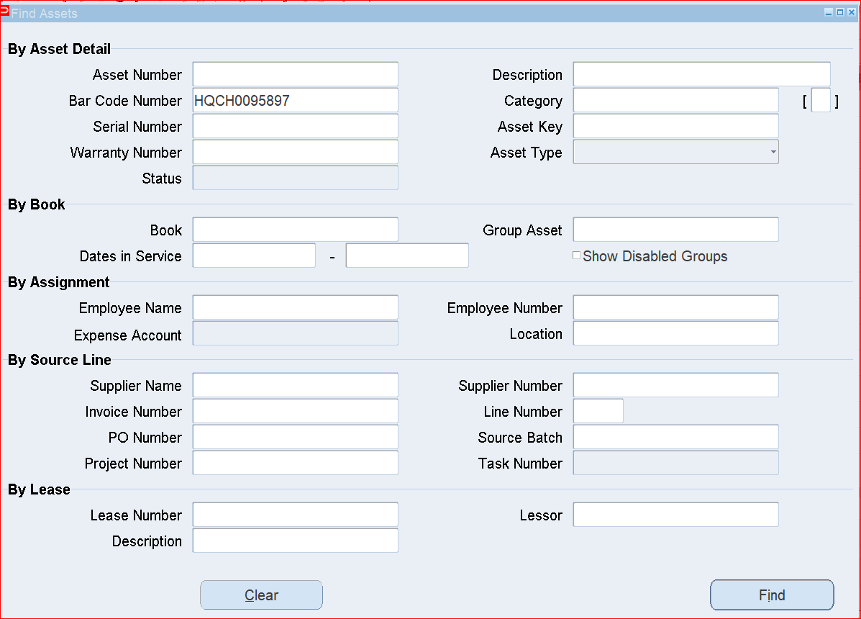
To check for Assignment (Custodian name, Custodian Number, Expensed Account and Location)
Enter the Barcode No of the asset
Click Find

Slide 5
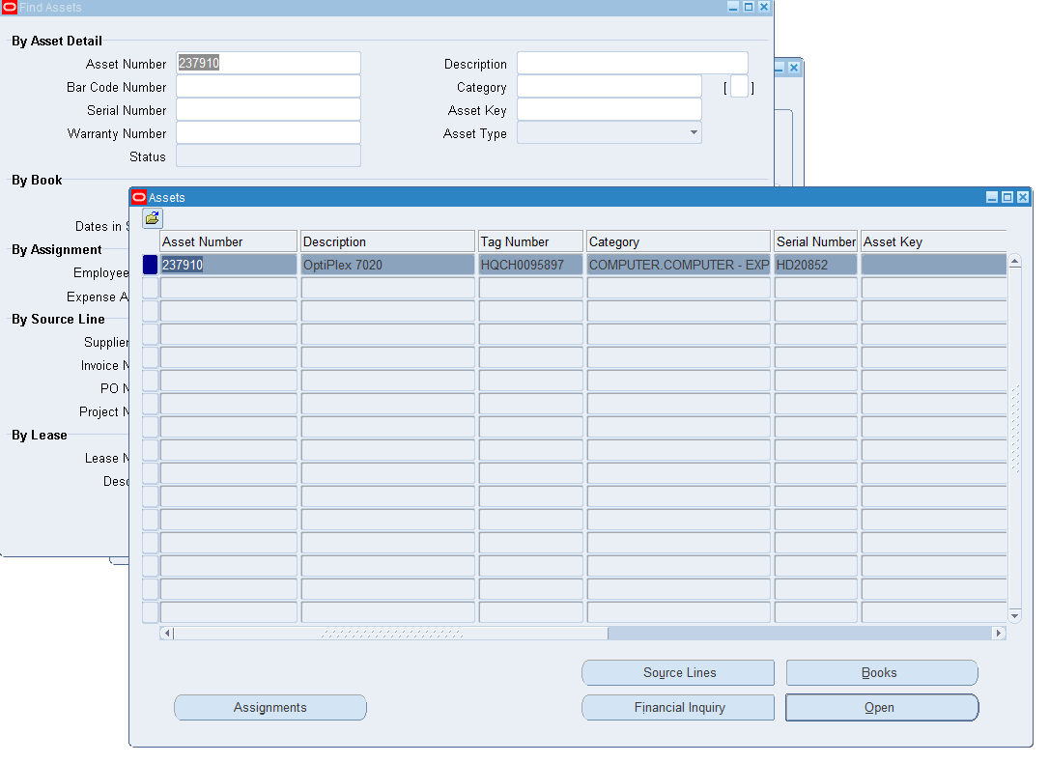
Click the
Assignment

Slide 6
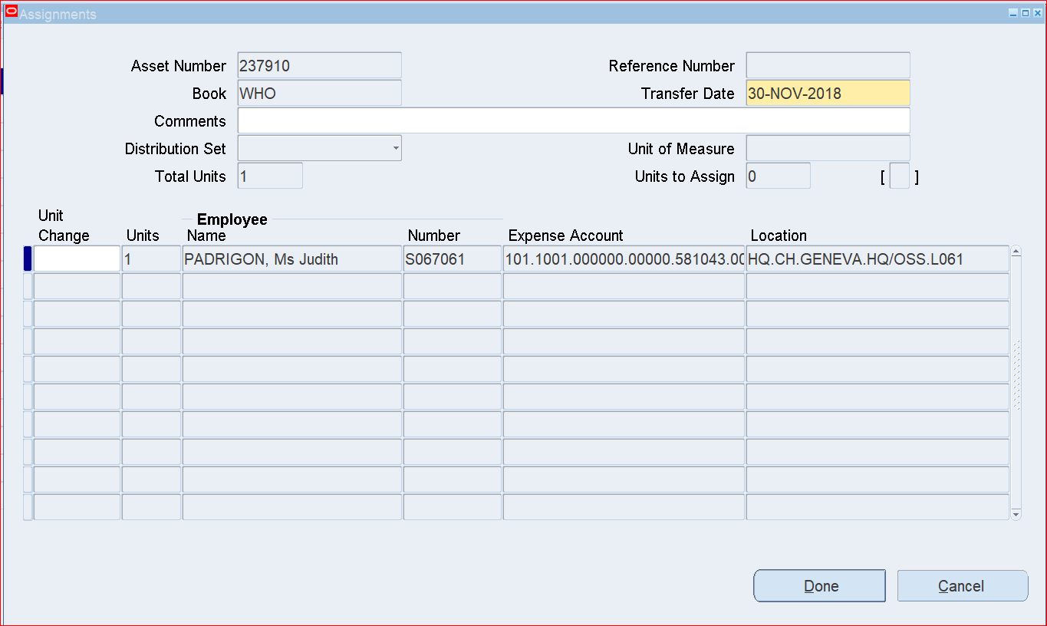
The Assignment Details (Employee Name and Employee Number, Expensed Account and Location) of an asset are displayed.

Slide 7
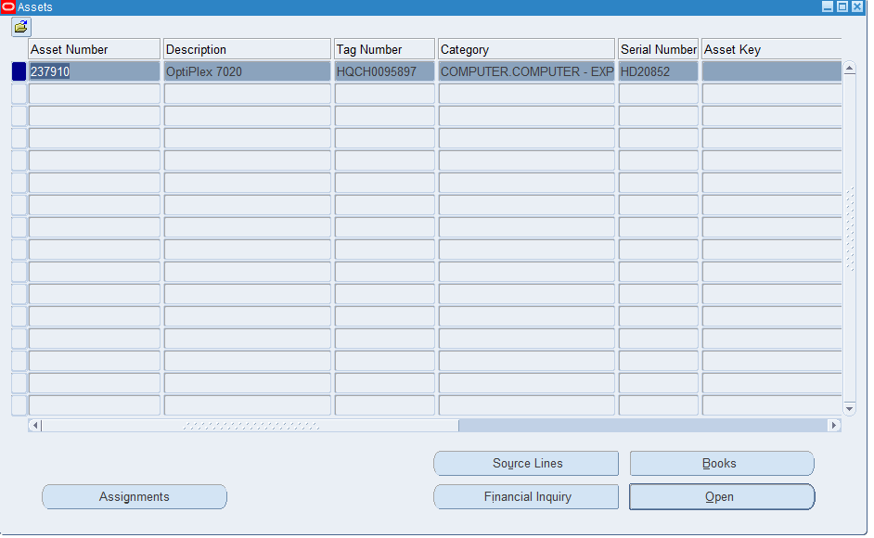
To check for PO number, Invoice number and Supplier
Click Source Line

Slide 8
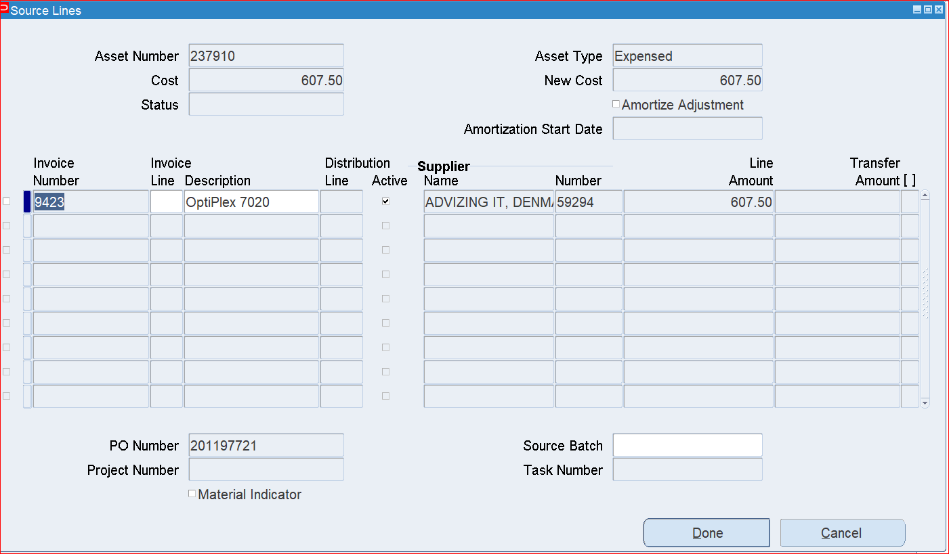
The PO number, Invoice number, Asset number, Supplier, Description and Amount are displayed

Slide 9
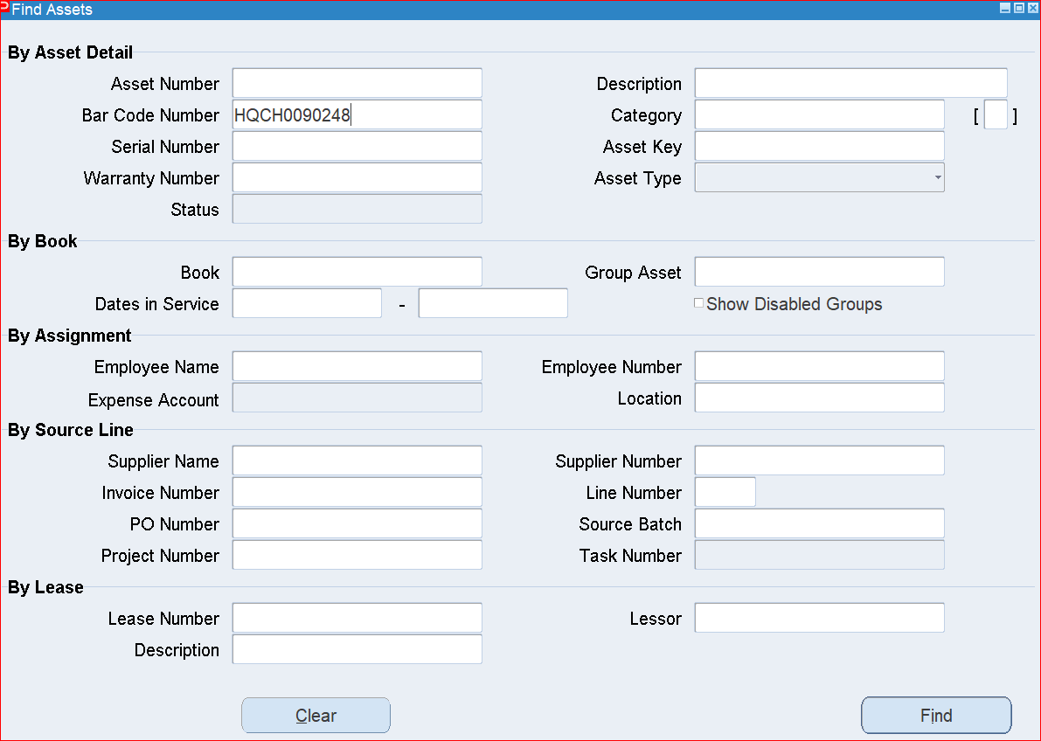
To check for Asset Financial Information (Date Placed in Service, Original Cost and Cost History
Enter the Barcode No of the asset
Click Find

Slide 10
Click Financial Inquiry

Slide 11
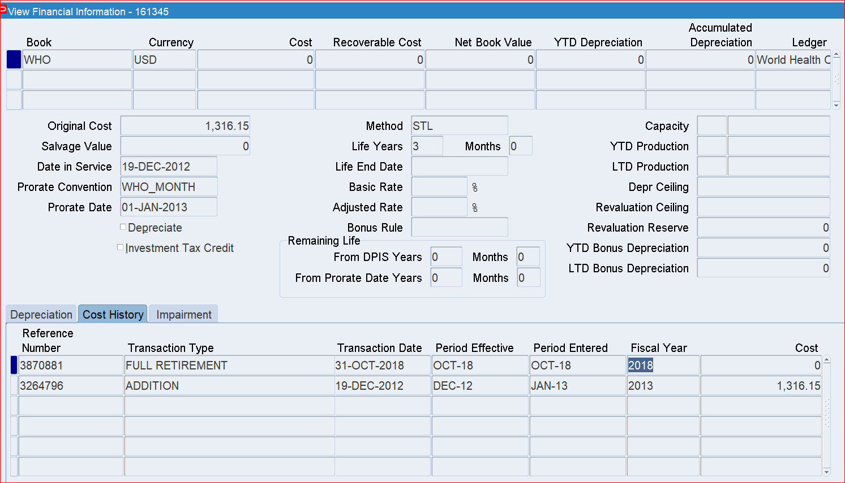
The Original Cost, Date Placed in Service, Transaction type, Transaction Date and Reference number, Net Book value and Net Book Value are displayed

